Slide 1
Optimizing Scaling Strategies for Social Buzz

Slide 2
01 Project Recap
Table of contents
02 Identified Problem
03 The Analytics Team
04 Proposed Solutions
05 Next Steps
06 Q&A

Slide 3
Project Recap
Since its inception in 2008, Social Buzz has been on an incredible journey. Starting as a small platform, it has grown into a social media giant with 500 million monthly users. This success story is marked by numerous achievements, including pioneering features that set new industry standards, breakthroughs in user engagement, and strategic market expansion. These accomplishments have firmly established Social Buzz as a leader in the social media landscape and have positioned it for a significant financial milestone with an upcoming IPO.
Social Buzz's journey is a testament to its adaptability and commitment to excellence. The platform has consistently evolved to meet user demands, navigate industry changes, and overcome various challenges. This relentless pursuit of innovation and excellence has driven its exponential growth and sustained its relevance in a competitive market.
However, like any rapidly growing platform, Social Buzz is facing a scaling problem. Our analytics team has worked diligently to understand the root causes of this issue and has identified potential solutions. We propose enhancing our infrastructure to improve server capacity and performance, implementing advanced algorithms for better load balancing and data processing, and streamlining the user interface to reduce latency. These steps are crucial to maintaining our growth trajectory and enhancing the user experience.
As we move forward, securing approval for these solutions and developing a detailed implementation plan will be our next priorities. We will closely monitor our progress and adjust strategies as needed. Your feedback and insights are invaluable to us, and we welcome your questions and discussions to ensure we continue to succeed together.

Slide 4

Process
Data cleaning and preparation.
Utilization of Excel functions (VLOOKUP, UMIF)
Microsoft Power BI
Identification of top 5 content categories
Economics thesis defense
Our analysis process involved meticulous data cleaning and preparation. Leveraging Excel functions such as VLOOKUP and SUMIF, we identified the top 5 content categories, with Travel emerging as the primary focus, followed by Science, Healthy Eating, Animals, and Cooking.

Slide 5
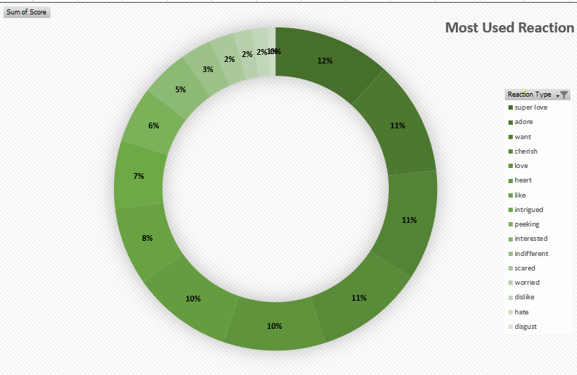
Insights
In the dynamic landscape of online content consumption, understanding user engagement is pivotal for content creators and platform administrators. This report delves into the intricate details of user interactions within a dataset encompassing diverse content categories, reactions, sentiments, and content types.
By unraveling patterns in user behavior, sentiment analysis, and content preferences, this report aims to equip stakeholders with actionable insights to refine content strategies, enhance user experience, and foster a more engaging online community. Let's embark on a journey to reveal key findings that illuminate the pathways to a more vibrant and responsive online content ecosystem
Content Relevance and Diversity: The dataset includes 16 unique content categories, accumulating a total score of N973,645.
Top 3 engaging categories: Animal, Science, Healthy Eating, with notable interest in Technology and Food.
The top three categories—Animals, Science, and Healthy Eating—likely resonate well with users due to their broad appeal and relevance. These categories may align with popular interests, thereby attracting a larger audience.

Slide 6



Scaling challenges faced by Social Buzz.
Need for external expertise due to:
Upcoming IPO by end of next year.
Limited resources for managing current scale.
Desire to learn data best practices from large corporations.
The identified problem centers around scaling challenges at Social Buzz.
With an IPO looming, limited resources, and a desire to adopt best practices from leading corporations, they recognize the need for external expertise.
Problem

Slide 7

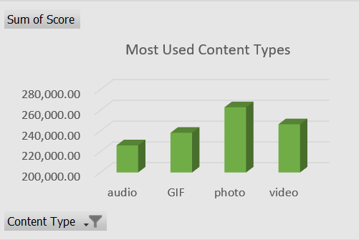
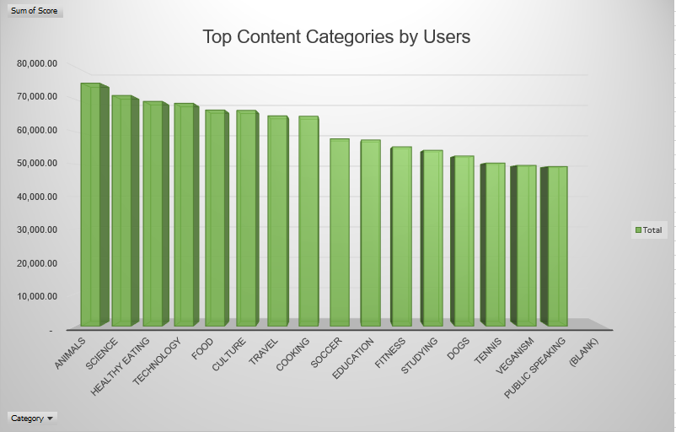
Content Type and Reaction Dynamics: Photo is the predominant content type, followed by Video and Gif.
Super Love, Adore, and Want are the most frequently used reactions The preference for photos over videos and GIFs indicates a user inclination towards visually engaging content.
Additionally, the popularity of reactions such as Super Love, Adore, and Want underscores the importance of emotive and expressive content that resonates with users on a deeper level.

Slide 8
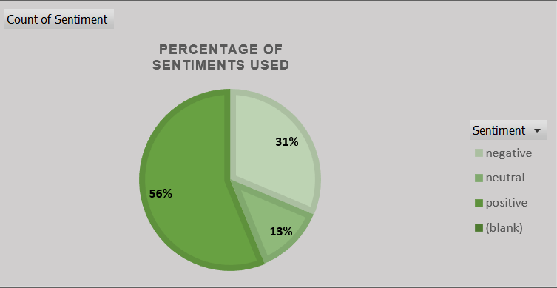
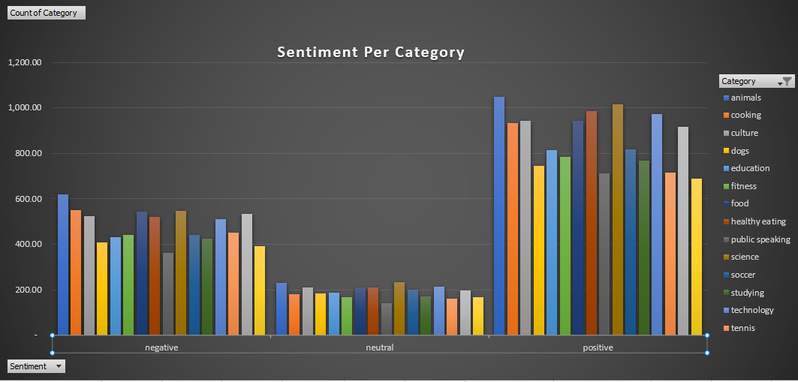
Positive Sentiment Dominance: :Overall, 56% of reactions convey a positive sentiment.
The prevalence of positive sentiments (56%) suggests that users predominantly engage with content that elicits positive emotions.
Positive sentiments might foster a more enjoyable and uplifting user experience, contributing to increased engagement.
User Sentiments Towards Categories: The alignment of positive sentiments towards categories like Animals, Dogs, and Cooking suggests that users generally associate positive emotions with these topics.
On the contrary, the observation of negative sentiments towards similar categories indicates a potential polarity in user opinions, necessitating a nuanced approach to content creation within these domains.

Slide 9
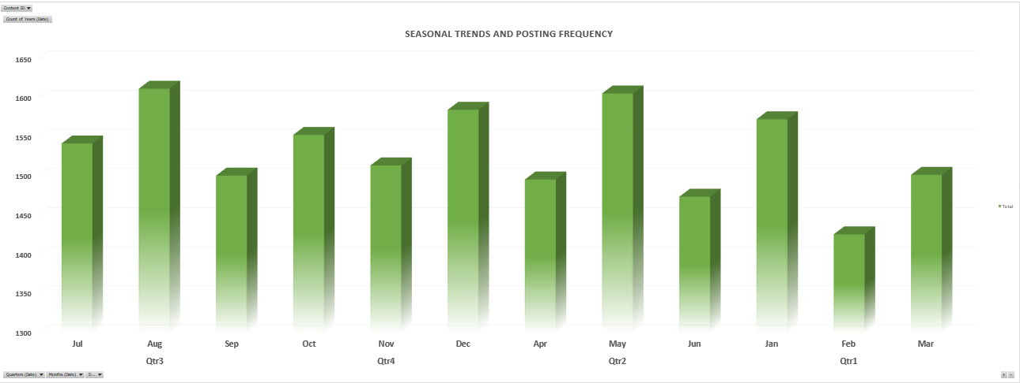

Seasonal Trends and Posting Frequency: The observation that August, representing Q3, had the highest post frequency implies potential seasonal trends or increased user activity during that period.
This insight could be linked to factors like holidays, special events, or simply heightened online activity during that specific month.

Slide 10
Summary
This report delved into user interactions, highlighting the dominance of Animals, Science, and Healthy Eating categories, totaling a score of N973,645.
Positive sentiments prevail, constituting 56% of reactions, with August in Q3 witnessing peak posting activity.
Photos lead as the preferred content type, and Super Love emerges as the top reaction. The report emphasizes user affinity for Animals, Science, and Healthy Eating content, while categories like Public Speaking, Veganism, and Tennis receive less attention.
These insights inform content strategies for heightened user engagement and satisfaction, promoting a positive platform experience

